Slide 1


PROJECT PRESENTATION
Submitted by
Sonu Kumar Rawani
Uid-22STNCJHN01005
PROGRAM –DIT(Computer Science) 2ND SEMESTER
Faculty Guide- Dr. Mansi Gupta

Slide 2
Topics for Summer Internship Program using C Programming language:-
INDEX
Calculate area, perimeter and circle using switch case .
Swastik pattern in programming (odd number).
Guessing the Animal and Bird name .
Mathematic Calculator (addition ,subtraction , multiplication , division ) using switch case.

Slide 3

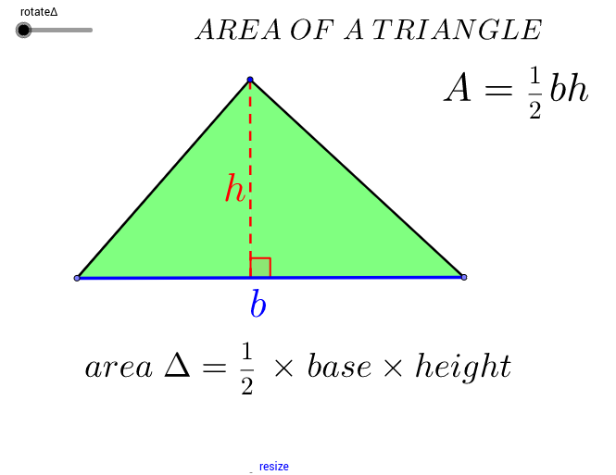
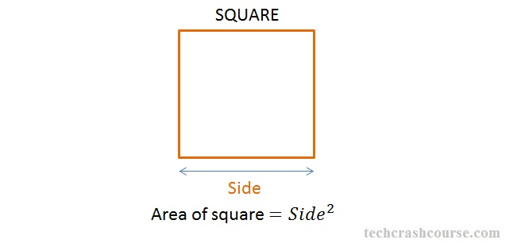
Calculate area, perimeter and circle using switch case .
AREA OF TRIANGLE
AREA OF SQUARE
The area of ​​a triangle is defined as the total area bounded by the three sides of a given triangle.
Area of a Triangle Formula:
If the base and height are given, the area of the triangle is determined using the formula.
AREA = 1/2∗breath∗height
Even all the angles of a square are also equal in nature. Since the sum of all angles of any quadrilateral is equal to 360 degrees. All the angles of a square are equal to 90 degrees, is called square.

Slide 4
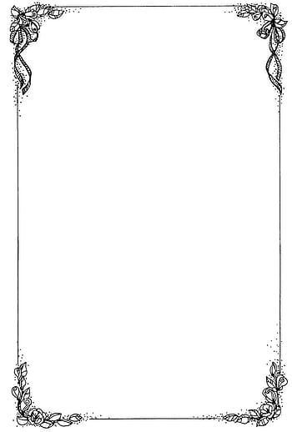
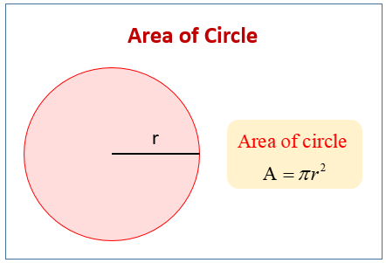
Circumference of
the circle
Area of the Circle
The area enclosed by Circle radius r.
The formula to calculate the area of a circle is:
A = πr²
Where:
A represents the area of the circle,
π (pi) is a mathematical constant approximately equal to 3.14159, and
r is the radius of the circle.
The distance around a circle of any curved geometrical shape its 1d pr 2d dimension
Formula to find circumference C = 2 * 3.14 * r( Radius).
Where: C represents the circumference of the circle, π (pi) is a mathematical constant approximately equal to 3.14159, and r is the radius of the circle.

Slide 5
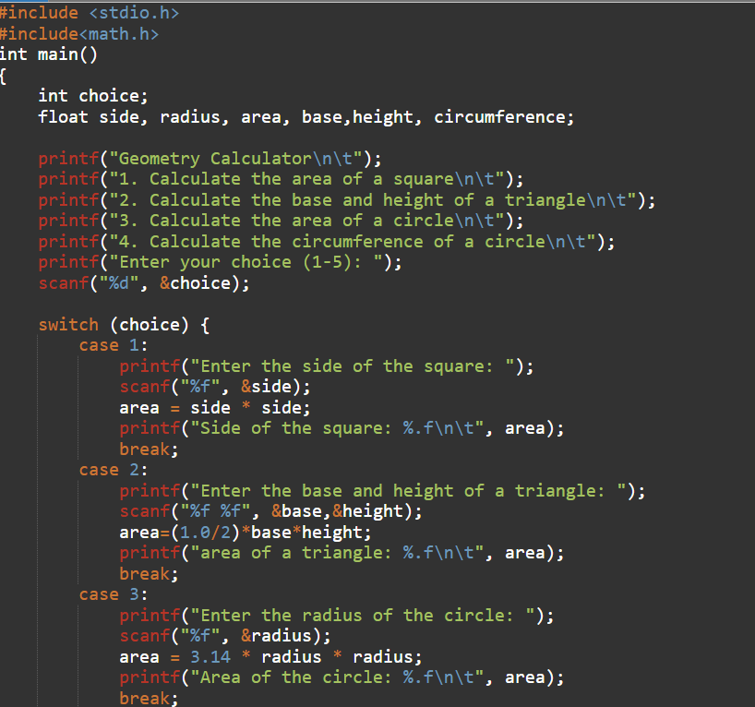
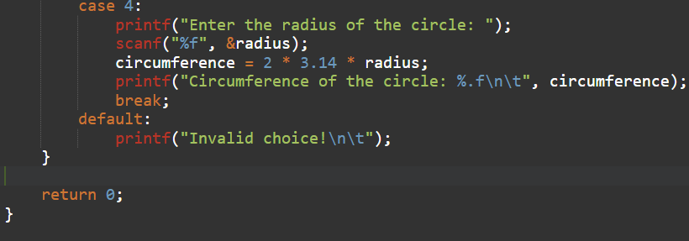
The given coding is of geometrical shape’s
(like ; square , circle, triangle) area and perimeter calculator.

Slide 6
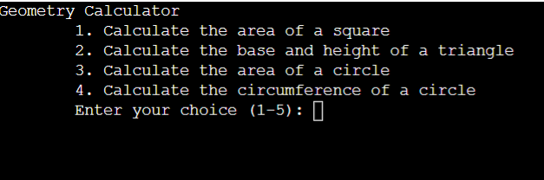
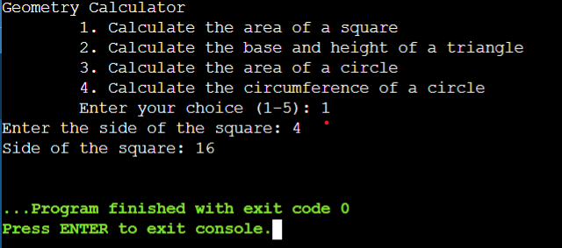
Screenshot of outputs
Enter choice ,what do you want to do
Entered choice is 1
Which is of finding the area of square with side 4
and it’s output is 16.

Slide 7
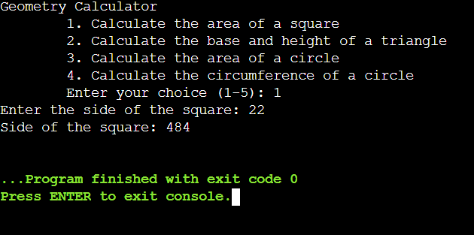
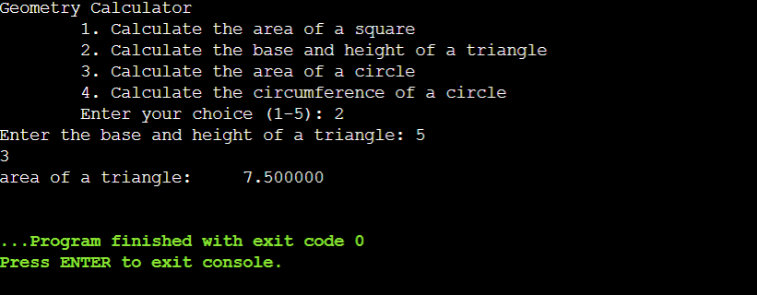
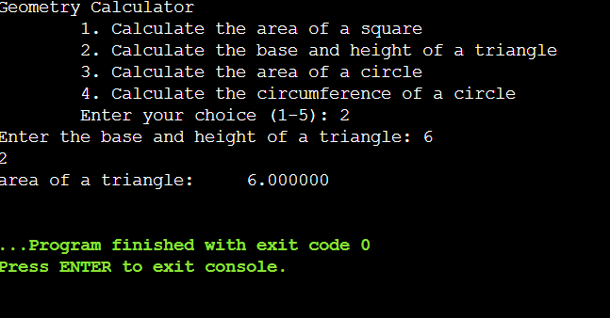
Entered choice is 1
Which is of finding the area of square with side 22and it’s output is 486.
Entered choice is 2
Which is of finding the area of a circle with height and base 5 or 3 and it’s output is 7.5000
Entered choice is 2
Which is of finding the area of a circle with height and base 6 or 2 and it’s output is 6.000

Slide 8
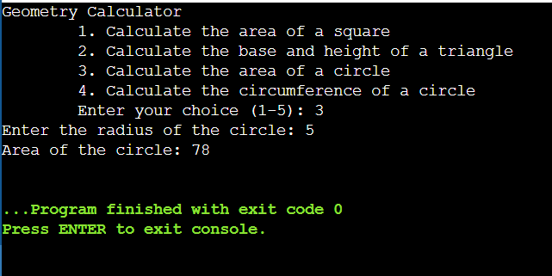
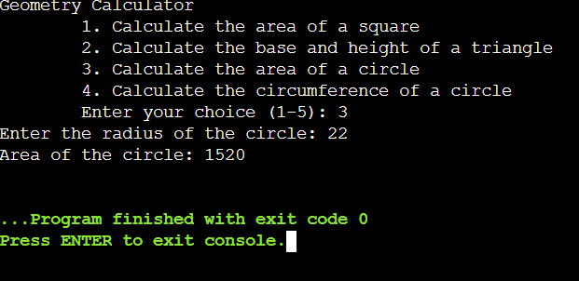
Entered choice is 3
Which is of finding the area of a circle with its radius o circle 5 and it’s output is 78.
Entered choice is 3
Which is of finding the area of a circle with its radius of circle 22 and it’s output is 1520.

Slide 9
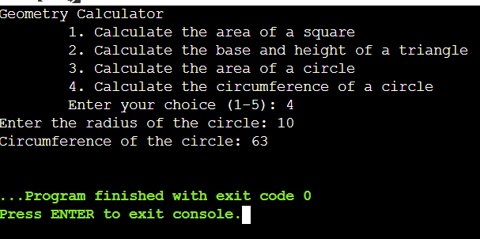
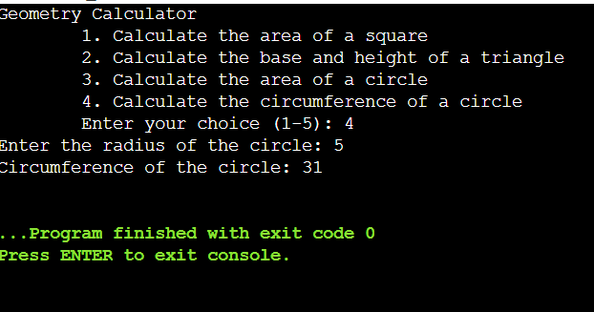
Entered choice is 4
Which is of finding the circumference of a circle with its radius o circle 10 and it’s output is 63.
Entered choice is 4
Which is of finding the circumference of a circle with its radius of circle 5 and it’s output is 31.

Slide 10
Topic 2:-Guessing the Animal and Bird name
In this program, the dictionary animals contains several animals along with their attributes. The guess _animal () function asks the user a series of questions and compares their responses with the attributes of each animal. If a match is found, the program will make a guess. Otherwise, it will inform the user that it couldn't guess the animal.

Slide 11
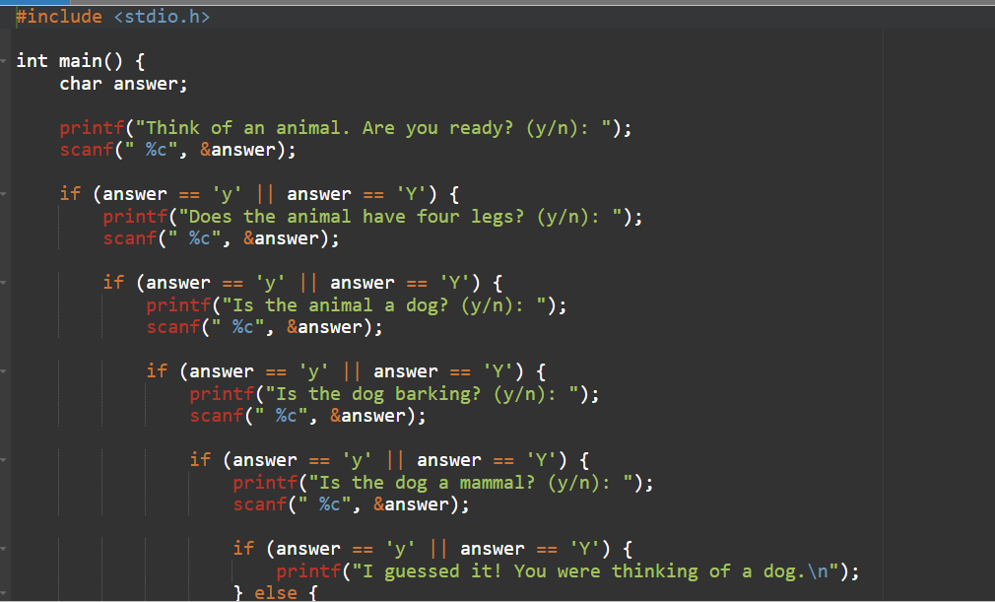
The given coding is the program uses a dictionary containing animals and their attributes to try and guess the animal based on user responses to a series of questions.

Slide 12
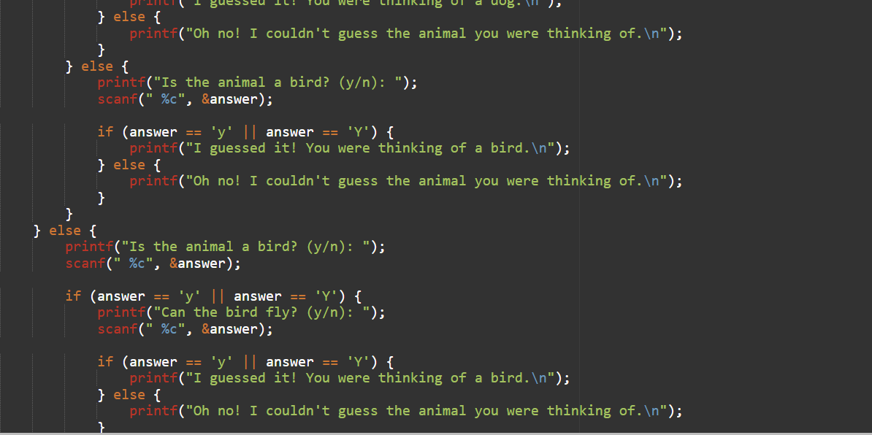
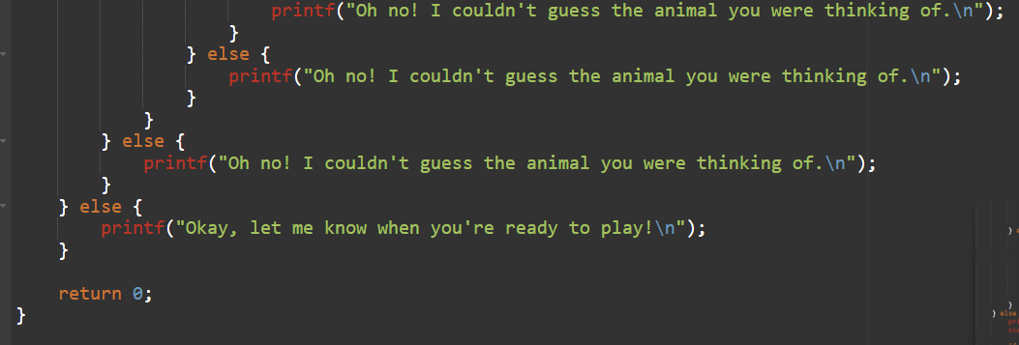
This coding is using switch case if else statement yes or no series are program.
The user can think the animal are dog or cat according to given program and finally the game is over and show result.

Slide 13
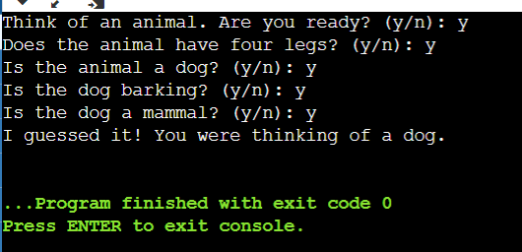
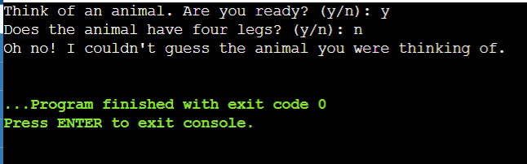
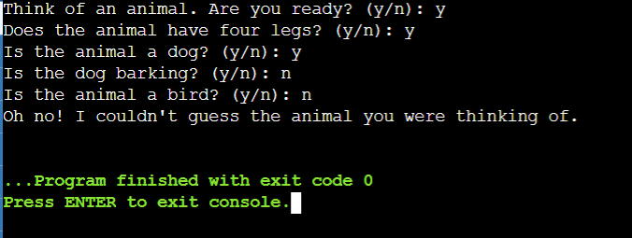
This is the output of animal think whether it yes or no if he press yes next question was similar to that one thinking based on I guessed means user guessed of dog..
This is the output of think of animal if user press yes its does animal have four legs.
If user press no the output will be I couldn't think you guess of animal.
This is the output showing if the user enter yes(y) then the animal recognized is a dog or else the animal is a bird.

Slide 14
Topic 3:- Swastik pattern in c programming odd numBers
This C program generates a Swastika pattern using asterisks (*) and spaces. It prompts the user to enter the number of rows and columns, ensuring that it is an odd number.
Here's an introduction to the program:
The program starts by including the standard input/output library (stdio.h).
The main() function is defined. It initializes variables rows and cols to store the number of rows and columns, respectively.
The user is prompted to enter the number of rows and columns using printf() and scanf() functions.
The program checks if the number of rows is even by using the modulus operator (%). If the number of rows is even, it displays an error message and terminates the program.
The number of columns is set equal to the number of rows is equal to the no of columns.

Slide 15
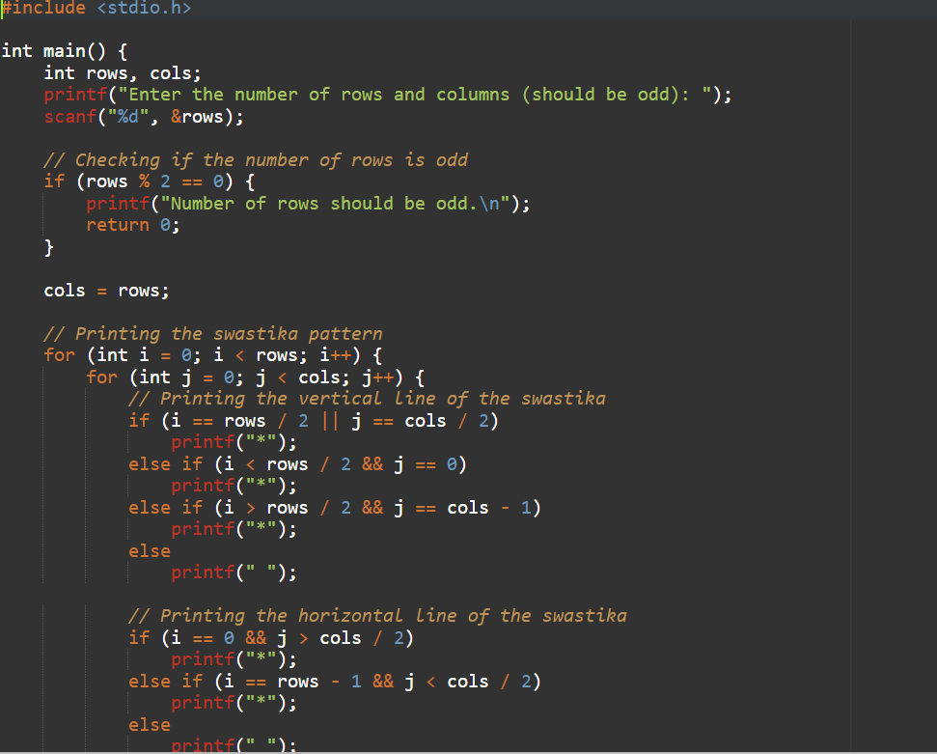
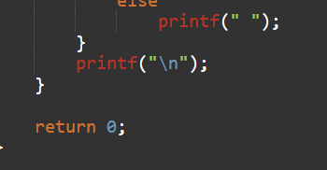
This C program generates a Swastika pattern using asterisks (*) and spaces. It prompts the user to enter the number of rows and columns, ensuring that it is an odd number.
In this program, rows and column are used by using switch case the final result show in swastik patern.

Slide 16
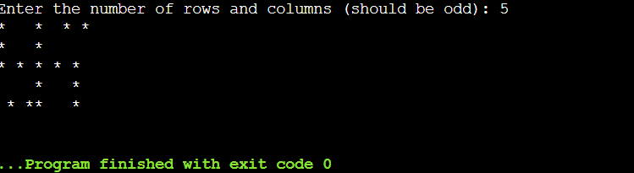
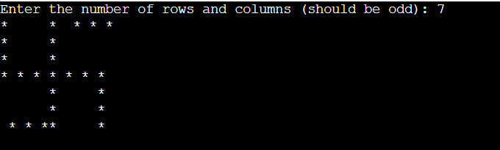
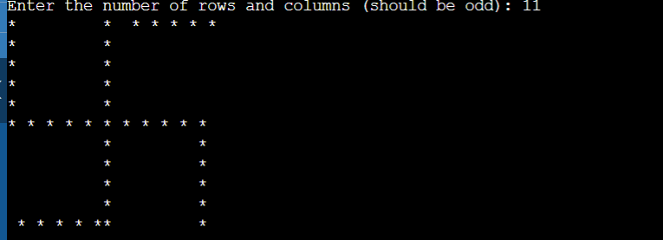
This is the output of swastika pattern based on no of rows and column show be same (odd number_) like 5
This is the output of swastika pattern based on no of rows and column show be same (odd number_) like 7
This is the output of swastika pattern based on no of rows and column show be same (odd number_) like 11

Slide 17
4:- Area of calculator (add,sub, multi, division) using switch case.
In this program, the user is prompted to enter an operator (+, -, *, /, or ^) to perform specific mathematical operations. Depending on the operator, the program asks for one or two numbers (base and exponent for ^ operator) from the user.
The program then uses a switch statement to perform the corresponding calculation based on the chosen operator. The result is stored in the result variable and displayed to the user with appropriate labels (e.g., sum, difference, product, quotient, or result).
To use this scientific calculator program, you can compile and run it with a C compiler. After execution, you will be prompted to enter the operator and the necessary numbers for the chosen operation, and the program will output the result.
In this device we are used how to calculate the method by using switch case we find addition of two number , subtraction of two no, multiplication of two no and Division of two number.

Slide 18
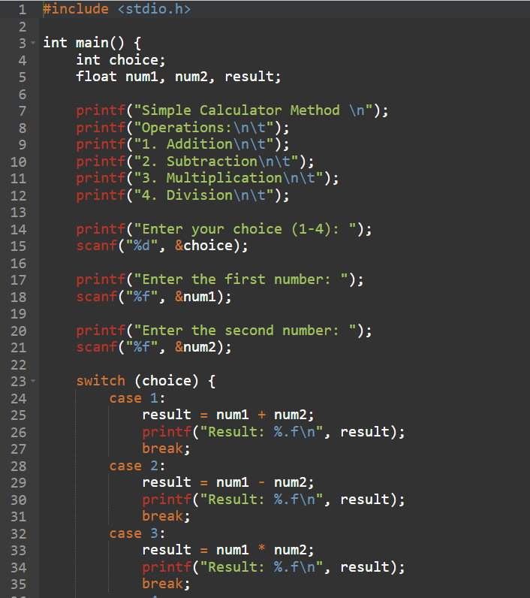
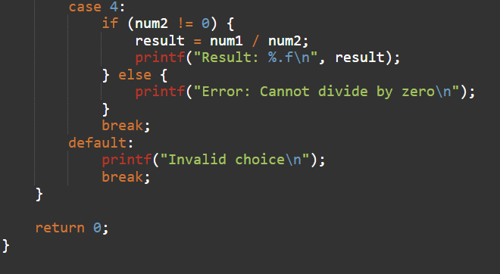
This given coding is Mathematical Calculator. In this Programming the using of Switch case Statement . If we press 1 for Addition, press 2 for Subtraction , press 3 for Multiplication and press 4 for Division.

Slide 19
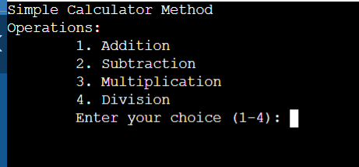
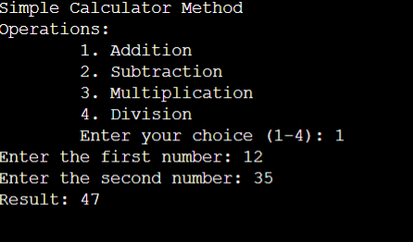
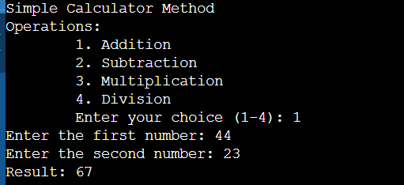
  Output of calculator program
The given output is to mathematical calculator , enter no 1(Addition) , the first no 44 and second no 23 and the given output is 67.
The given output is to mathematical calculator , enter no 1 (Addition) , the first no 12 and second no 35 and the given output is 47.
Enter choice ,what do you want to enter

Slide 20
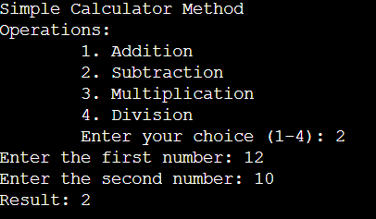
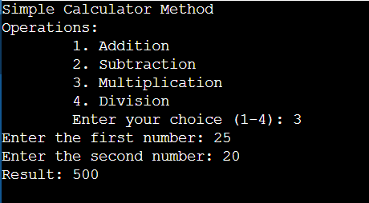
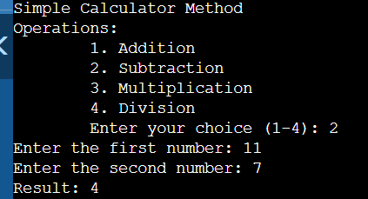
The given output is to mathematical calculator , enter no 2 (Subtraction) , the first no 12 and second no 10 and the given output is 2.
The given output is to mathematical calculator , enter no 2 (Subtraction) , the first no 11 and second no 7 and the given output is 4.
The given output is to mathematical calculator , enter no 3 (Multiplication) , the first no 25 and second no 20 and the given output is 500.

Slide 21
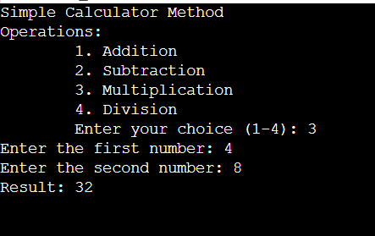
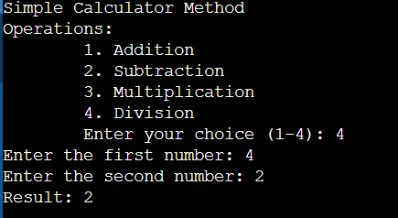
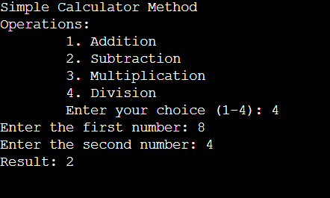
The given output is to mathematical calculator , enter no 3 (Multiplication) , the first no 4 and second no 8 and the given output is 32.
The given output is to mathematical calculator , enter no 4 (Division) , the first no 4 and second no 2 and the given output is 2.
The given output is to mathematical calculator , enter no 4 (Division) , the first no 8 and second no 4 and the given output is 2.

Slide 22

Thank
You…

